Slide 1

Patient reported experience measures
Lab meeting 04/10/19
Dr Iona Talintyre

Slide 2
Was there anything that you thought was really good?
All of it!
Fantastic team, thanks
Excellent
Most things
Good
Fantastic service, highly recommended
Dr Pickard & team are brilliant, caring , listened & took my concerns on board
The doctor looked at the case in real detail
The discussion and Q&A was really helpful in getting my questions answered
Clear explanations about issue and treatment
It's a fantastic idea to have the paediatrician at the GP, it's great. Very reassuring
Bob was really friendly and explained it all so clearly
Everything was good
The doctors took the time to visit his properly and to answer all my questions
Everyone listened to all my concerns
It is good to have the opportunity to see the paediatrician at the GP if/when need it
Someone taking notes as we talked
Providing a bigger picture response to a series of separate incidents
Lovely input from all those present
Fantastic service
The doctors are good, thank you
Yes, they gave me a clear explanation about the matter
Doctors bedside manner was excellent
Checking in system good, doctor was punctual, good surroundings
They were really amazing and listened

Slide 3
Was there anything that you thought could have been better?
Bit more examination
Not really
No!
Yes, rescheduling of appointment confusion
No
Too many people in a tiny room
No
No, it was great
Having a panel of 3 people was a bit weird
Waiting time to see the paediatrician
No, excellent
The waiting time to see the paediatrican would have been sooner
No, excellent

Slide 4
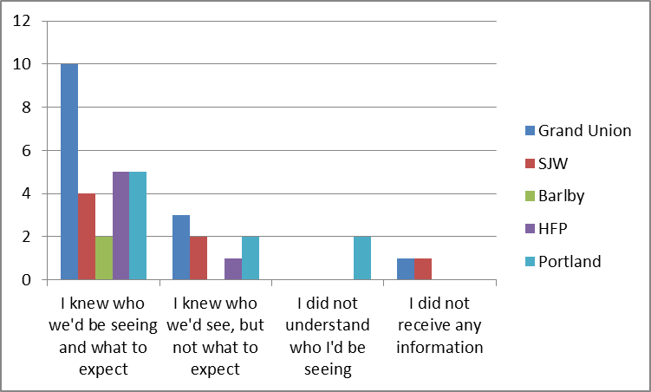
When you were referred to the Outreach service, did you receive enough information to let you know what to expect?
68% knew who they’d see & what to expect
11% did not understand / did not receive any information

Slide 5
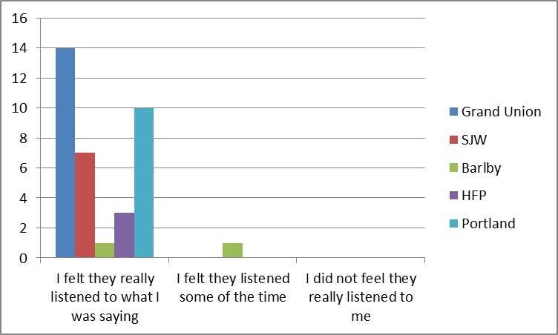
At the Outreach clinic, did the doctor(s) listen to what you had to say?
97% felt the doctors really listened to what they were saying

Slide 6
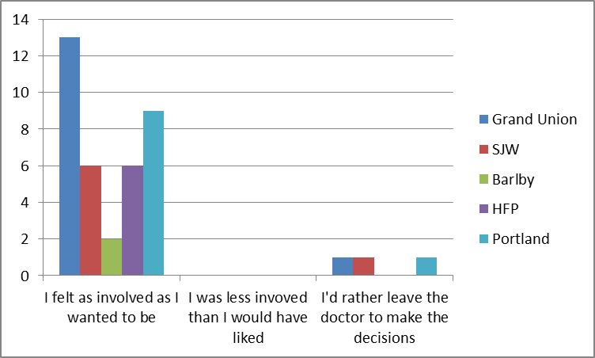
Were you involved as much as you wanted to be in decisions about treatment?
No-one felt less involved than they would have liked

Slide 7
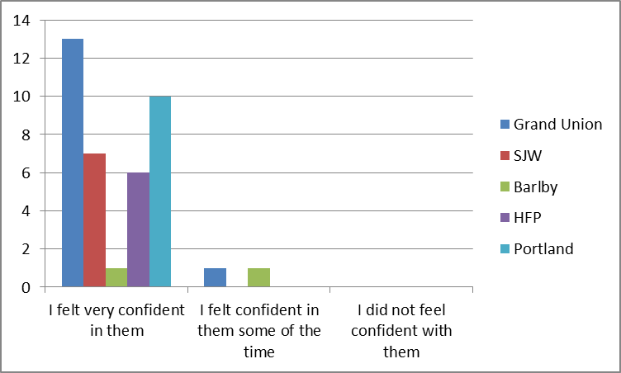
Did you have confidence and trust in the doctor(s) examining and treating your child?
95% felt very confident in the doctors

Slide 8
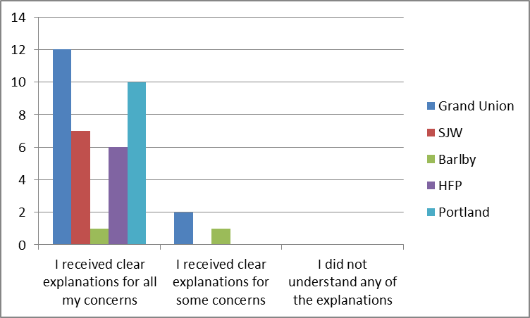
Did the doctor(s) address your concerns and provide clear explanations in a way that you could understand?
92% received clear explanations for all their concerns

Slide 9
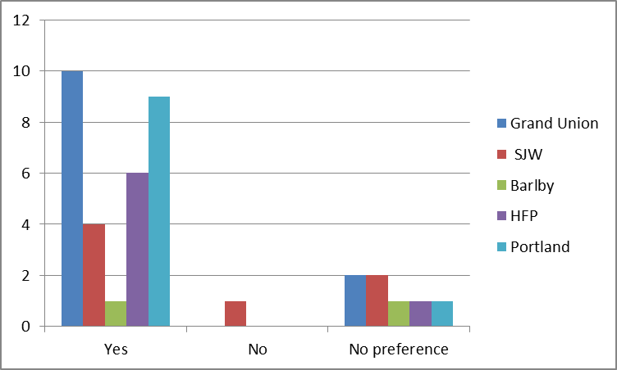
Did you prefer having this appointment at the GP surgery rather than the hospital?
79% preferred having the appointment at the GP surgery
18% had no preference

Slide 10
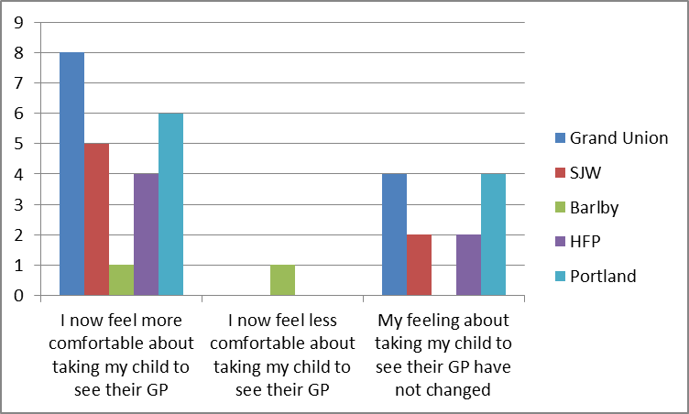
Has seeing a hospital paediatrician in the GP surgery changed the way you feel about your child's future care at the GP practice?
65% now feel more comfortable about going to the GP
32% felt no different about going to the GP

Slide 11
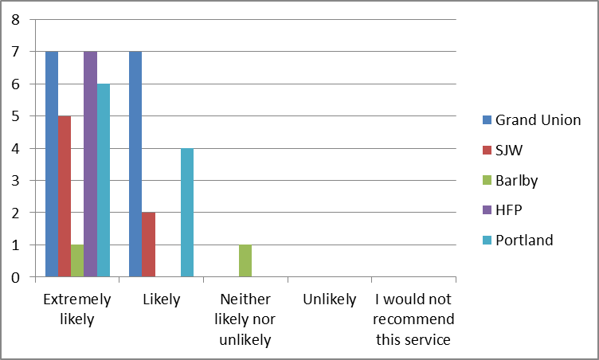
How likely is it that you'd recommend this service to your friends and family?
98% were likely or extremely likely to recommend this service

Slide 12
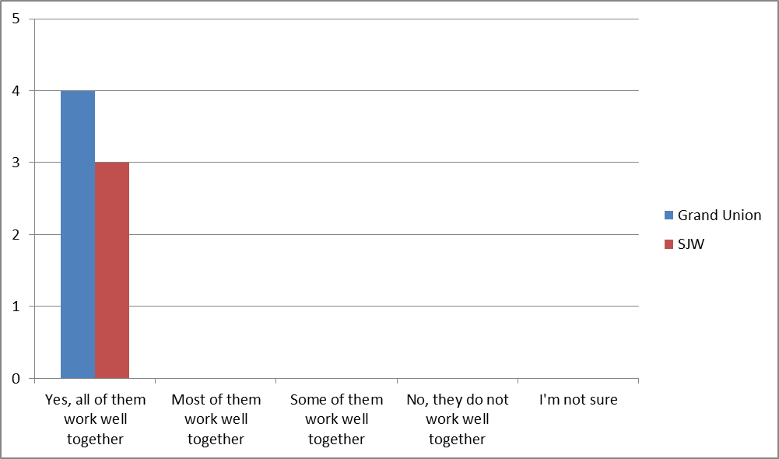
Do all the different people treating and caring for your child work well together to give you the best possible care and support?
100% felt everyone works well together

