Slide 1
HEEADSSS
Social History for Young People
7 minute teaching module
St Mary’s Hospital
Imperial College
Katie Malbon 2021

Slide 2
Why take a social history?
Developmental stage defined by risk taking and exploration of boundaries, can be overwhelming
Significant health risks as a result
  e.g. unprotected sex→STIs; RTAs account for 30% of teenage deaths; accidents/violence/suicide are top 3 causes of death
These health risks are largely preventable
A psychosocial history may detect problems early enough to intervene and prevent escalation of risky behaviours, reducing morbidity and mortality
  >25% of suicides are preceded by an A&E attendance with self-harm in the previous year

Slide 3
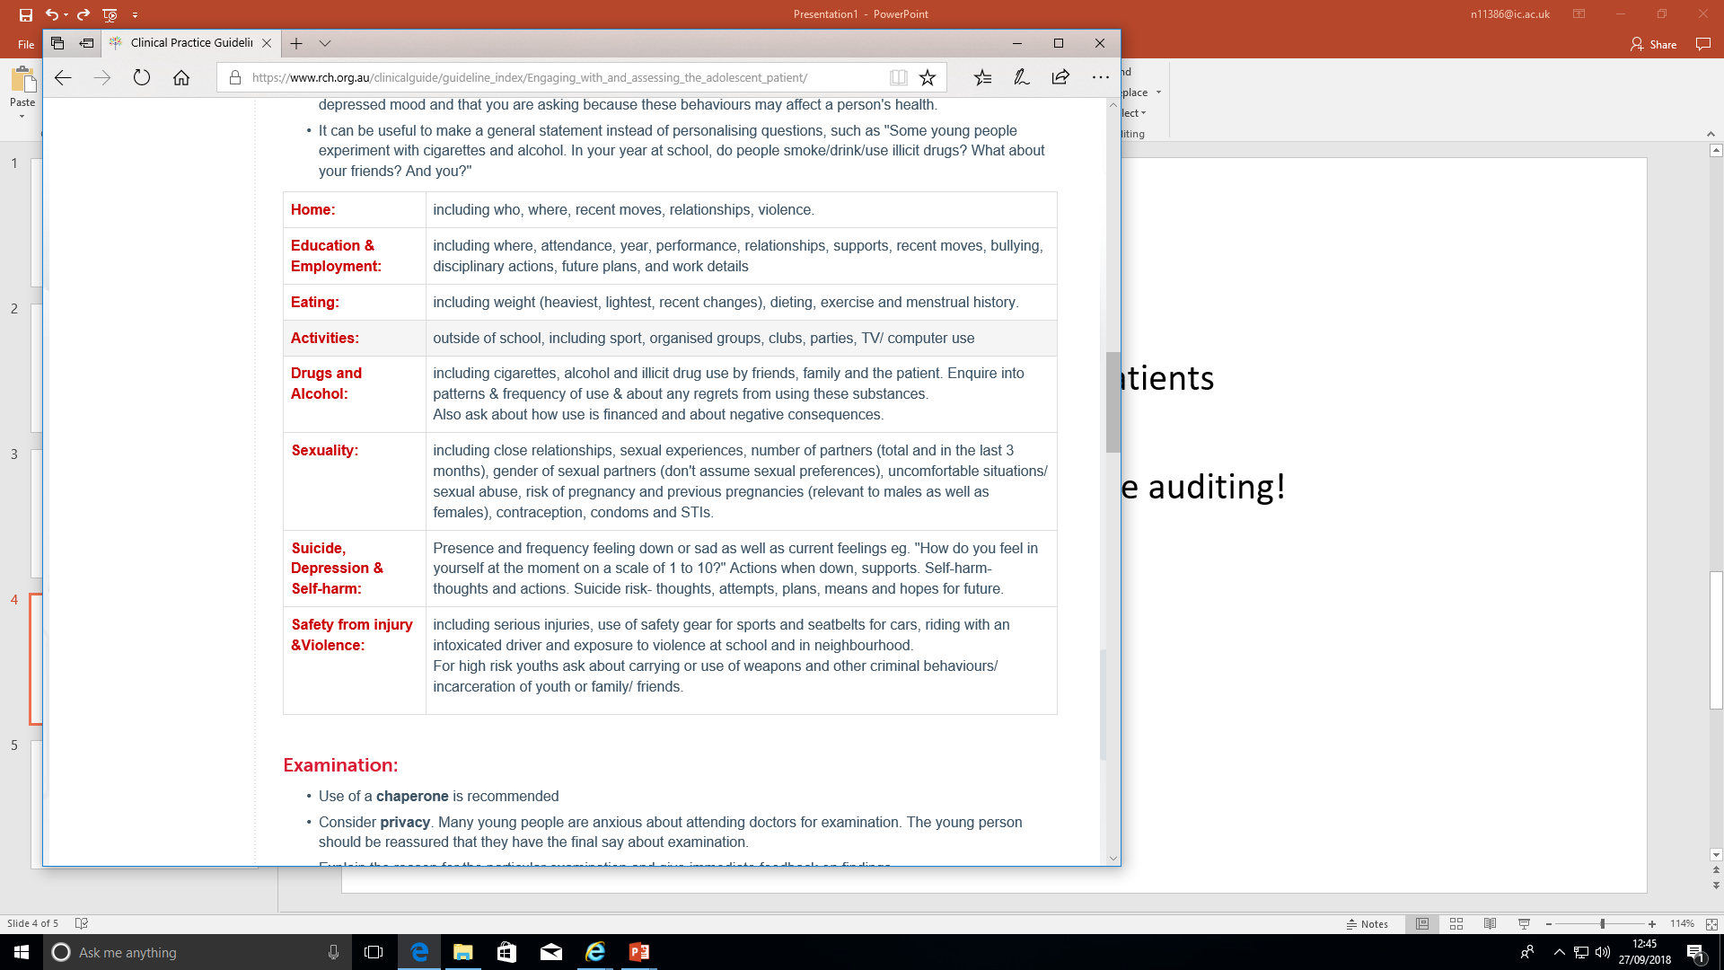
What is HEEADSSS?

Slide 4
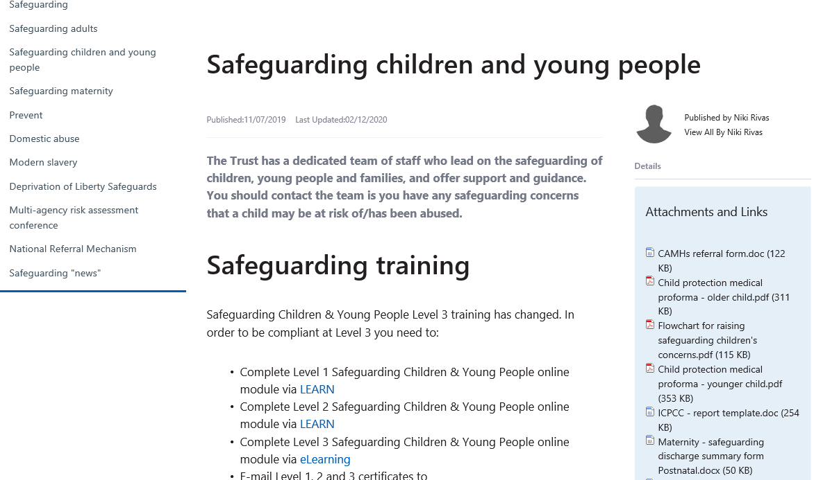

Doing a HEADSSS screen - where to find it on the intranet
Notes:
Demonsrate how to access proforma on The Source

Slide 5
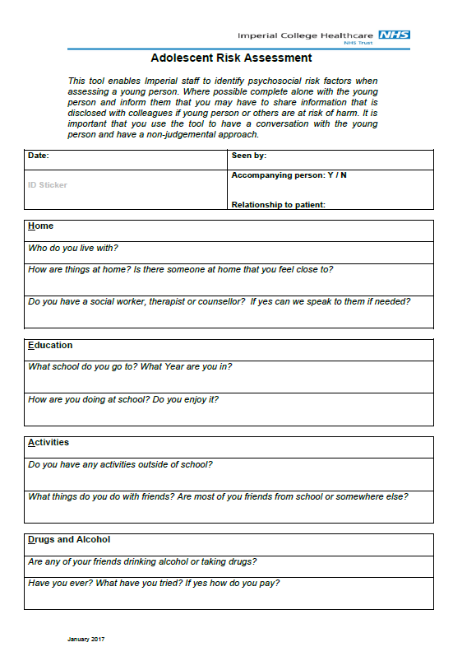
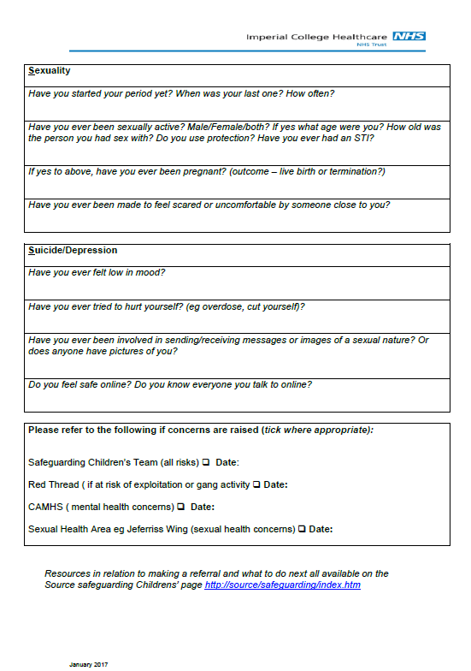
Notes:
Starting out
- can do home and education section at start with parents present; create a psychosocial tree
if only one parent mentioned must ask: where is dad, do you see him?
Important to ask open questions that help them to describe their situation; in a non-judgemental way
“Normalising” can help e.g. “I see a lot of young people who are experimenting with drugs…” or starting by asking about what the young person’s friends are doing
Then talk through the proforma with a few quick examples of “good questions”/how to ask different questions in each category
Home
Some examples of good questions “who is the person at home who understands you the best? What would you change about home?”
Education/Environment
Some examples of good questions: “what do you like best/worst about school? What would you change about school? Are you the sort of person that has one close friend/few friends/lots of friends?”
Activities
Some examples of good questions: “What do you do on the weekends? Who do you do those things with? Are most of your friends from school or somewhere else? Are they the same age as you?”
Drugs
Some examples of good questions: “When you go out with your friends or to party, do most of the people that you hang out with drink or smoke? Do you? How much and how often? Do any of your family members drink, smoke or use other drugs? If so, how do you feel about this - is it a problem for you? How do you pay for your cigarettes, alcohol or drugs?”
Sexuality
Some examples of good questions: “Are you attracted to boys/girls/both/not sure?”
Suicide
Some examples of good questions: “Would you describe yourself as a worrier or a relaxed kind of person?” etc

Slide 6
Examples on how to ask questions
“Who lives with you? Where do you live?”
“Tell me about school. What are your plans for future work?”
“Does your weight or body shape cause you any stress? If so, tell me about it.”
“What do you do for fun? How do you spend time with friends?”
“Do any of your friends smoke cigarettes or drink alcohol? Other drugs?
And how about you?”
“Have you ever been in a romantic relationship? Have any of these
relationships been sexual? How would you describe your sexuality?”
“Tell me about the things that tend to get you down or stressed. What do you do when you feel worried? Have you thought about hurting yourself or someone else?”
“Have you ever been seriously injured? Have you been picked on or bullied? Is there a lot of violence at home, or among your friends? Do you feel safe online?”

Slide 7
Doing a HEEADSS screen well…wrapping up
Summarising
Give an opportunity to voice any other concerns
Reinforce confidentiality and what they are happy for you to share
Offer resources (see YP blog on CC4C website)
Notes:
- Ask them to sum up their life in one word or to give the overall “weather report” for their life (sunny with a few clouds, very sunny with highs all the time, cloudy with rain likely, etc.).
- Ask them to tell you whom they can trust and confide in if there are problems in their lives, and why they trust that person.
- Give them an opportunity to express any concerns you have not covered, and ask for feedback about the interview. If they later remember anything they have forgotten to tell you, remind them that they are welcome to call at any time or to come back in to talk about it.
- For teenagers who demonstrate significant risk factors, relate your concerns. Ask if they are willing to change their lives or are interested in learning more about ways to deal with their problems. This leads to a discussion of potential follow-up and therapeutic interventions. Many adolescents do not recognize dangerous life-style patterns because they see their activities not as problems but as solutions. Your challenge lies in helping the adolescent to see health risk-taking behaviours as problems and helping to develop better strategies for dealing with them.
- If the adolescent’s life is going well, say so. In most cases, you can identify strengths and potential or real weaknesses, and discuss both in order to offer a balanced view.
Ask if there is any information you can provide on any of the topics you have discussed, especially health promotion in the areas of sexuality and substance use. Try to provide whatever educational materials young people are interested in.

